Slide 1
9.7 Feature Selection via Regularization

Slide 2
With the first approach to feature selection discussed in the previous Section - boosting - we took a 'bottom-up' approach to feature selection.
That is we began by tuning the bias and then added new features to our model one-at-a-time.
In this Section we introduce a complementary approach - called regularization.

Slide 3
Instead of building up a model 'starting at the bottom', with regularization we take a 'top-down' view...
...and start off with a complete model that includes every one of our input features...
...and gradually remove input features of inferior importance.
We do this by adding a second function to our cost - called a regularizer - that penalizes weights associated with less important input features.

Slide 4
Regularization using simple vector norms

Slide 5
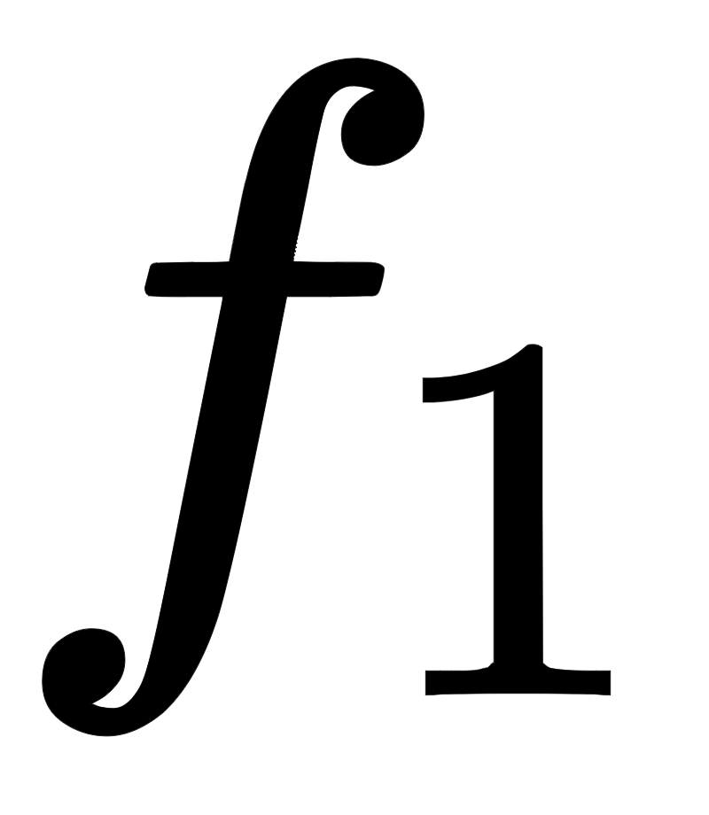
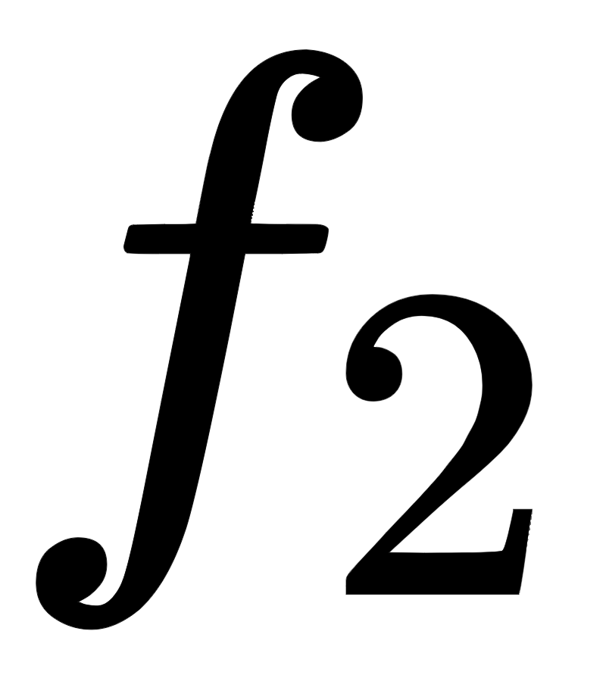

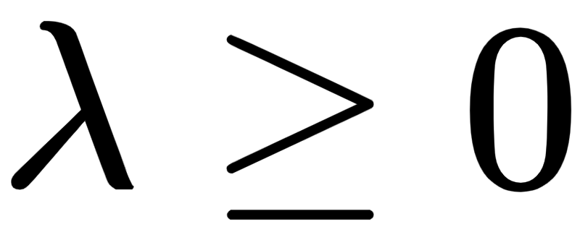
The simple linear combination of two functions and
is often referred to as regularization in the parlance of machine learning.
More specifically the function is called a regularizer in the jargon of machine learning, since by adding it to function we adjust its shape
and is referred to as a penalty or regularization parameter.

Slide 6
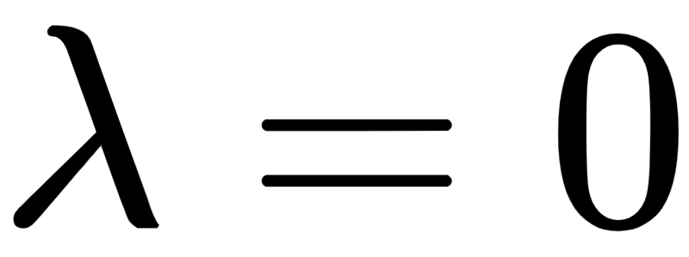
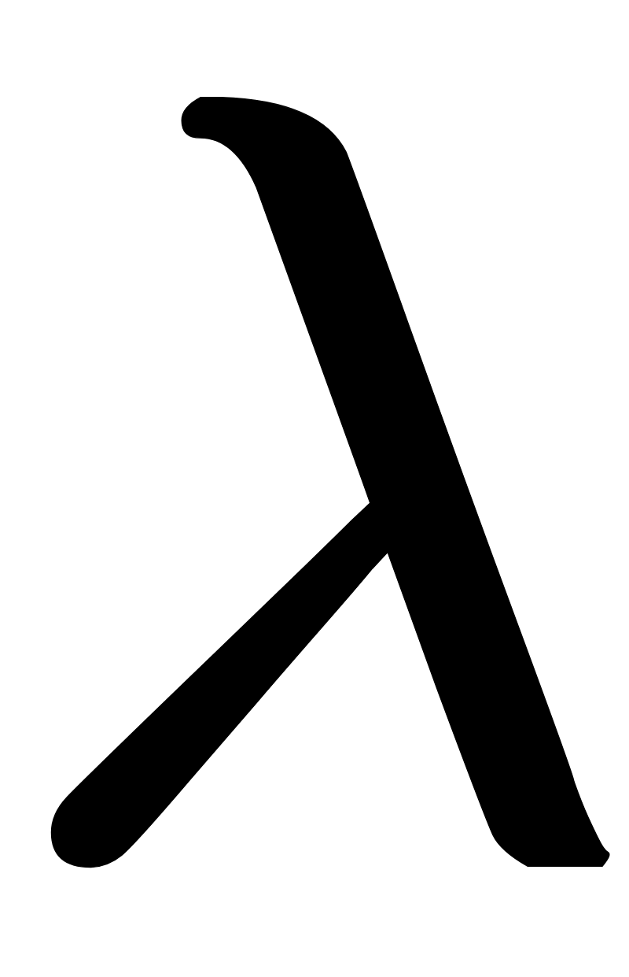
We have already seen one instance of regularization in discussing how to adjust Newton's method to deal with non-convex functions in Chapter 5.
Here when the above combination reduces to , and as we increase the two functions and 'compete for dominance' in a linear combination.
As we set to larger and larger values the function dominates the combination, and eventually completely drowns out function .
In this instance what we end up with is a highly positively scaled version of the regularizer .

Slide 7
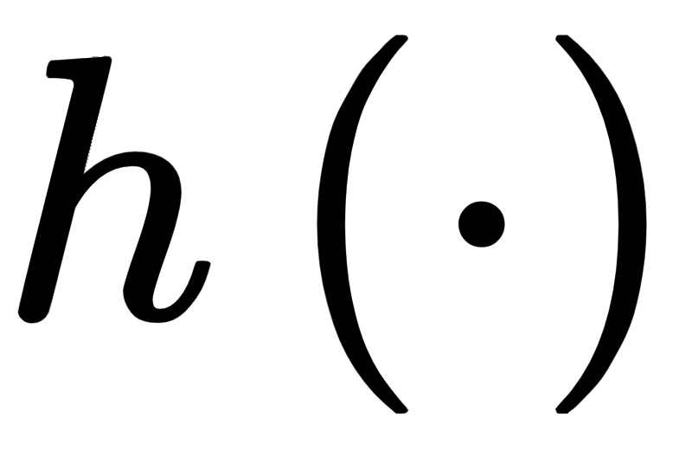


Suppose we added a generic function to one of our supervised learning functions
e.g., the Least Squares , giving a regularized linear combination of our cost function

Slide 8
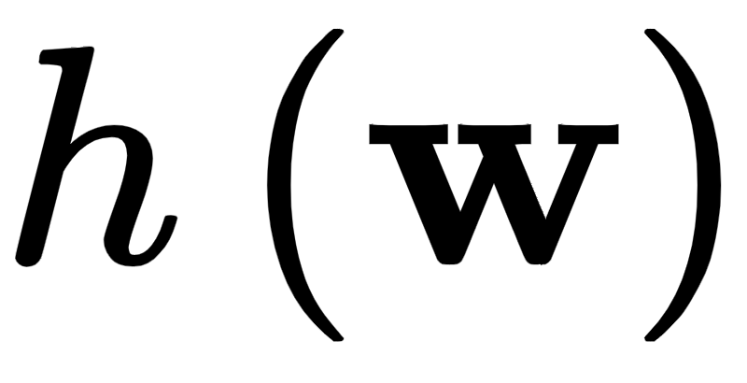
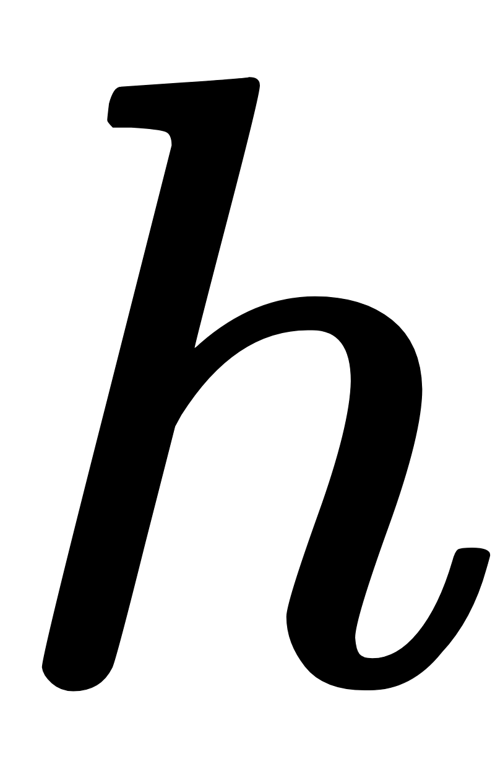
By adding the regularizer to g we alter its very nature, and in particular change the location of its minima.
The larger we set the regularization parameter the more the combination f drifts towards a positively scaled version of the regularizer with minima that mirror closely those of

Slide 9
By carefully engineering ‘h’ and the value of , we can construct a *regularized* form of the original cost function that retains the essence of g...
...in that it measures a regression error of a model against a set of input/output data points - but whose altered minima better reflect only the most input features of a dataset.

Slide 10
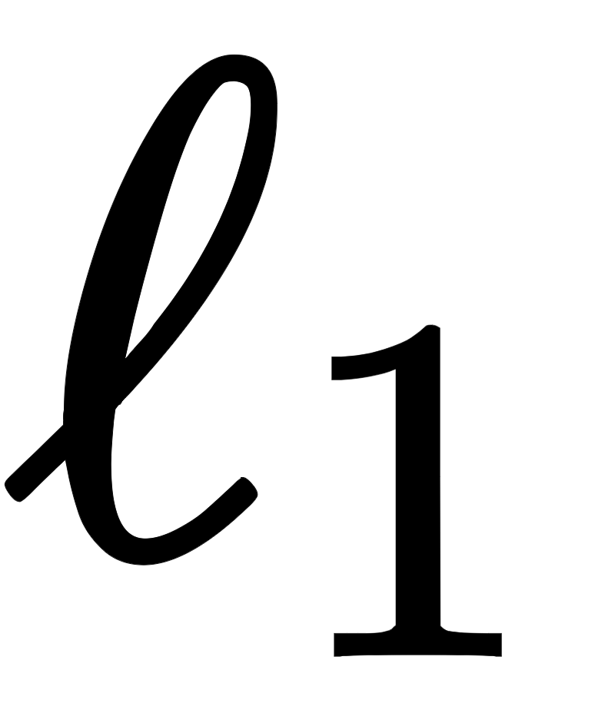
One can do this just as easily with a convex combination of a cost function and another function ‘h’ - but the regularization paradigm is more popular in machine learning.
A common choice for ‘h’ that achieve these desired aims is a vector norm - in particular the so-called norm.
Remember that a vector norm is a simple function for measuring the *magnitude* or *length* of a vector (see Appendix for further details).
Below we discuss several basic choices of vector norms, the latter two of which are very commonly used in machine learning applications.

Slide 11
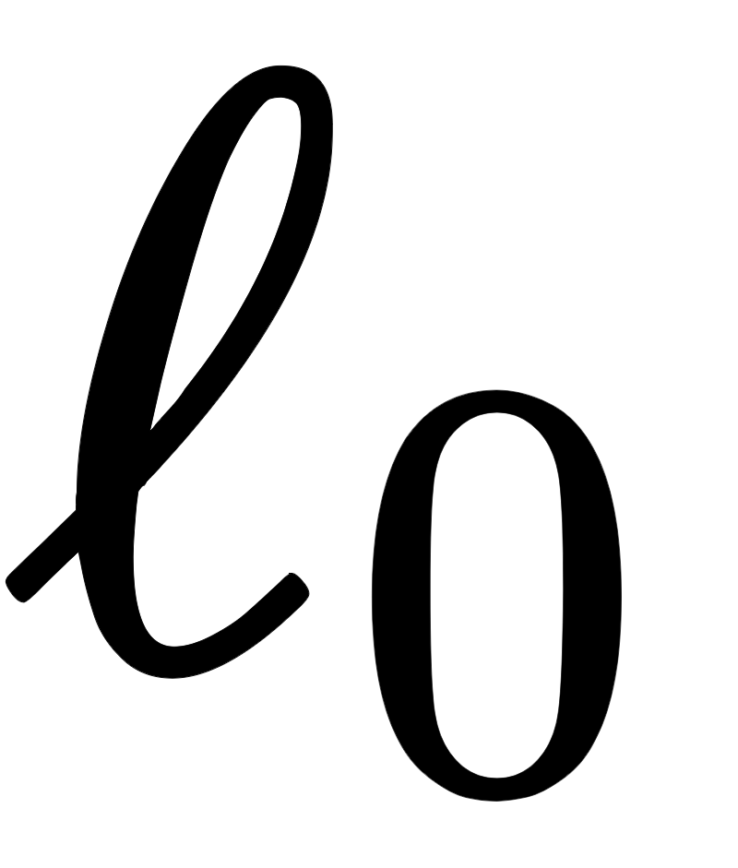
Regularization using the norm

Slide 12
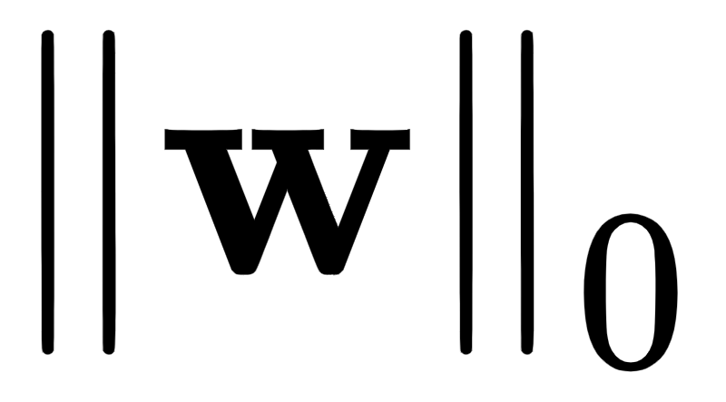

The vector norm, written as , measures 'magnitude' as
If we regularize a cost g using it

Slide 13

Here we are penalizing the regularized cost for every non-zero entry of since every non-zero entry adds +1 to the magnitude
Conversely then, in minimizing this sum, the two functions ‘g’ and 'compete for dominance' with ‘g’ wanting to be resolved so that we attain a strong regression fit...
...while the regularizer aims to determine a 'small' that has as few non-zero elements as possible (or - in other words - a weight vector that is very *sparse*).

Slide 14
Regularization using the norm

Slide 15
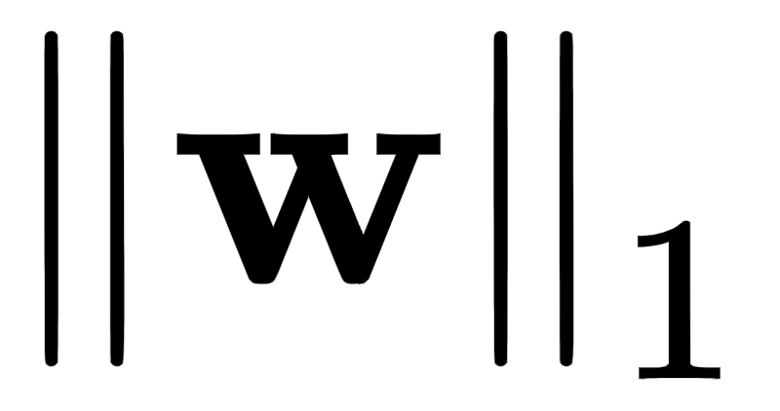
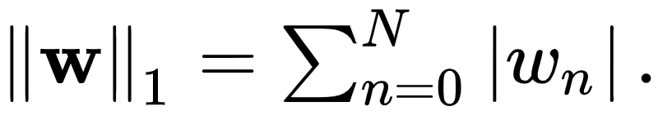

The vector norm, written as , measures 'magnitude' as
If we regularize a regression cost g (or - as we will see - any machine learning cost) using it
notice what we are doing: we are penalizing the regularized cost *based on the sum of the absolute value of the entries of .

Slide 16
Conversely then, in minimizing this sum, the two functions g and 'compete for dominance'
with g wanting to be resolved so that we attain a strong regression fit, while the regularizer aims to determine a that is small both in terms of the absolute value of each of its components
but also - because the norm is so closely related to the norm - one that has few non-zero entries and is quite *sparse*.

Slide 17
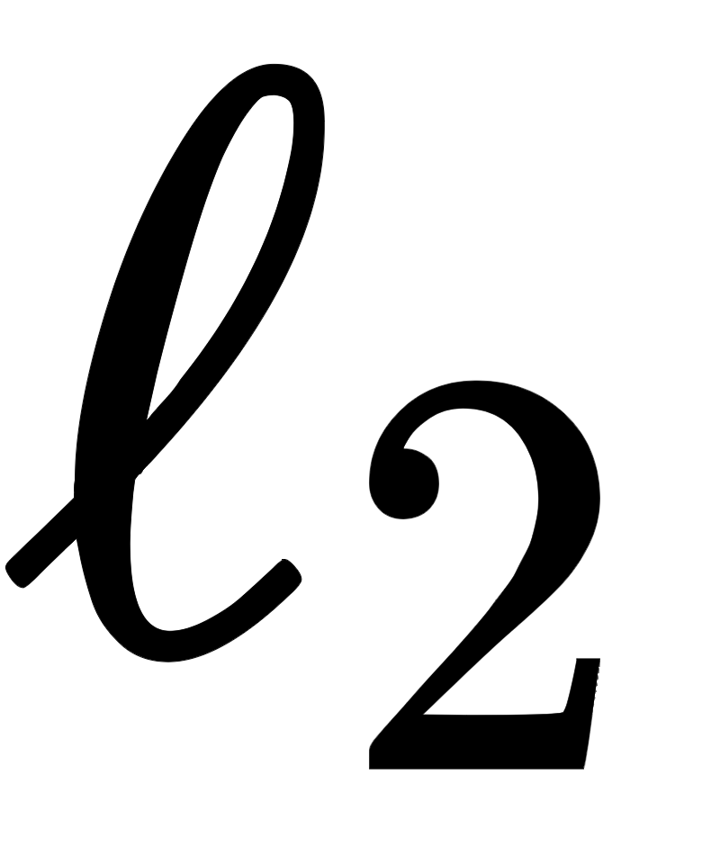
Example: Regularization using the norm

Slide 18
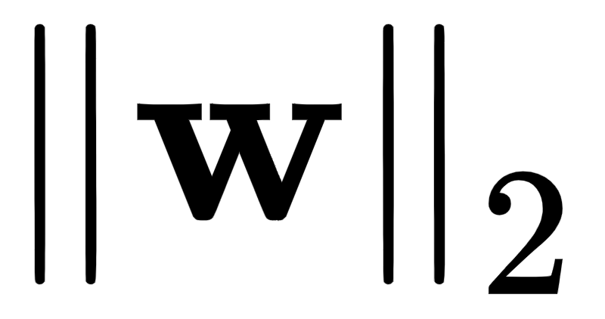
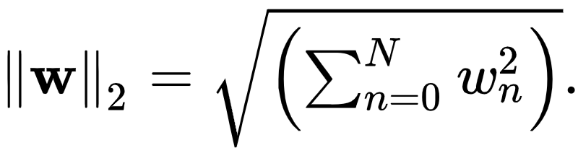

The vector norm, written as , measures 'magnitude' as
If we regularize a regression cost g (or - as we will see - any machine learning cost) using it
notice what we are doing: we are *penalizing* the regularized cost based on the sum of squares of the entries of .

Slide 19
Conversely then, in minimizing this sum, the two functions g and 'compete for dominance'
with g wanting to be resolved so that we attain a strong regression fit
while the regularizer aims to determine a that is small in the sense that *all of its entries* have a small *squared* value.

Slide 20
Feature selection via regularization

Slide 21
From the perspective of machine learning, by inducing the discovery of *sparse minima* the and reguarlizers help uncover the identity of a dataset's *most important features*:
these are precisely the features associated with the non-zero feature-touching weights.
This makes both norms - at least in principle - quite appropriate for our current application.

Slide 22
On the other hand, the drive for general 'smallness' induced by minimizing a cost with the regularizer means - provided is set correctly - that typically *every* weight is included in the minima recovered.
This makes the intuitively less appealing for the application of feature selection (although it is used throughout machine learning as a regularizer for applications other than feature selection, as we will see).

Slide 23
Of the two sparsity-inducing norms described here the norm - while promoting sparsity to the greatest degree - is also the most challenging to employ since it is *discontinuous*.
This makes the minimization of an regularized cost function quite difficult.
While the norm induces sparsity to less of a degree, it is *convex and continuous* and so we have no practical problem minimizing a cost function where it is used as regularizer.
Because of this practical advantage the norm is by far the more commonly used regularizer for feature selection.

Slide 24
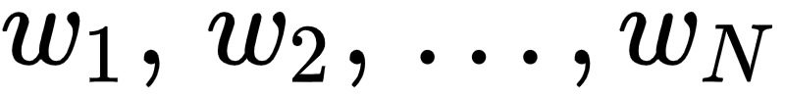
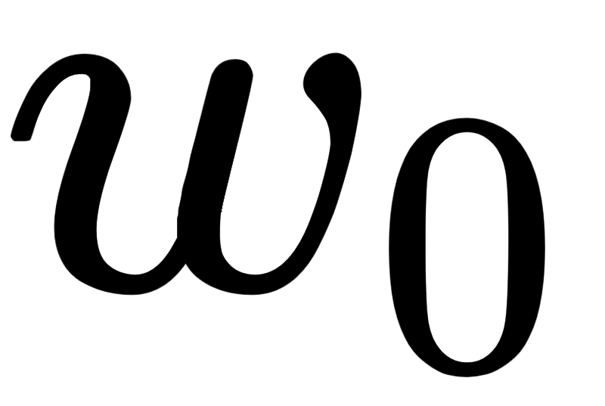

Finally, remember that when performing feature selection we are only interested in determining the importance of feature-touching weights
So we only need regularize them (and not the bias weight ), and so our regularization will more specifically take the form
And note here g is any supervised learning cost function.

Slide 25
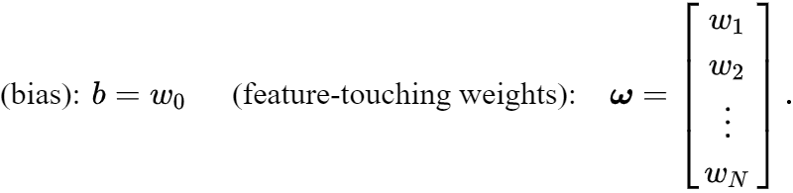

Using our individual notation for the bias and feature-touching weights
we can write this general regularized cost function equivalently as

Slide 26
What value should be set too?

Slide 27
Because feature selection is done for the purposes of *human interpretation* the value of can be based on several factors.
A benchmark value for can be hand chosen based on the desire to explore a dataset, finding a value that provides sufficient sparsity while retaining a low cost value.
Finally, can be chosen entirely based on the sample statistics of the dataset via a procedure known as cross-validation (which we discuss in Section 12.6).

Slide 28
Regardless of how we select , note that because we are trying to determine the *importance* of each input feature here that before we begin the process of regularization we *always need to standard normalize the input to our dataset* as detailed in [Section 9.3].
By normalizing each input feature distribution we can fairly compare each input feature's contribution and determine the importance of each.

Slide 29
Exploring features for predicting housing prices via regularized regression

Slide 30
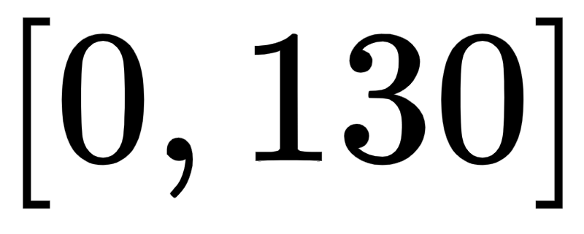
In this example we use the Boston Housing dataset first introduced in Example 1 of the previous Section.
This dataset consists of P=506 datapoints with N=13 input features relating various statistics about homes in the Boston area to their median values (in U.S. dollars).
We use regularization with 50 evenly spaced values for in the range .

Slide 31
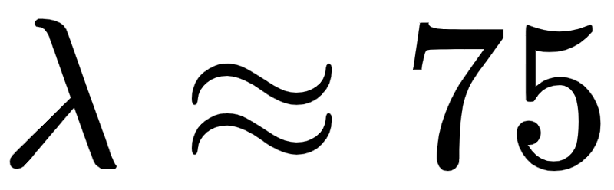
Shown in the animated figure below is a histogram of the optimal *feature-touching* weights recovered by minimizing an regularized Least Squares cost function with these various values.
Moving the slider from its starting position on the left (where ) rightwards increases the value of and the associated optimal set of weights are shown.
By the time three major weights remain, corresponding to feature 6, feature 13, and feature 11. The first two features (6 and 13) were also determined to be important via boosting - and can be easily interpreted.

Slide 32
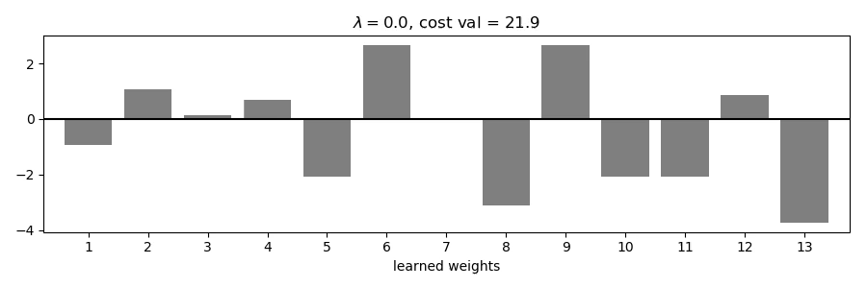

Slide 33
In comparison to the result found via boosting, the third feature 11 found to be important here was *not* found to be as important via boosting.
Conversely as is increased to even small values notice how many of the large (in magnitude) feature-touching weights seen when quickly disappear
in particular feature-touching weights 8 and 11 rapidly vanish (which were deemed more important when applying boosting).

Slide 34
Below we show the an analogous run - using the same range of values for - employing the norm.
This does not sparsify the resulting weights like the norm does, and so results in optimal weights that are less human interpretable.

Slide 35


Slide 36
Comparing regularization and boosting

Slide 37
While boosting is an efficient greedy scheme, the *regularization* idea detailed above can be computationally intensive to perform since for each value of tried a full run of local optimization must be completed.
On the other hand, while boosting is a 'bottom-up' approach that identifies individual features one-at-a-time, regularization takes a more 'top-down' approach and identifies important features *all at once*.
In principle this allows regularization to uncover groups of important features that may be correlated in such an interconnected way with the output that they will be missed by boosting.

